Slide 1



Introduction to Open-Source

Slide 2






What are Open Source Software?
1. Open Source Software 2. Proprietary Software

Slide 3
Popular Open Source Programs
Google Summer of Code
Digital Ocean Hacktoberfest
Outreachy
Google Season of Docs
More Programs: All Open Source Programs

Slide 4
Benefits
Networking and Collaboration
Opportunity to showcase skills
Getting familiar with Git and Github
Respect in Open Source community
Get deeper knowledge of the tech stack

Slide 5
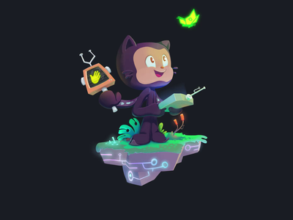
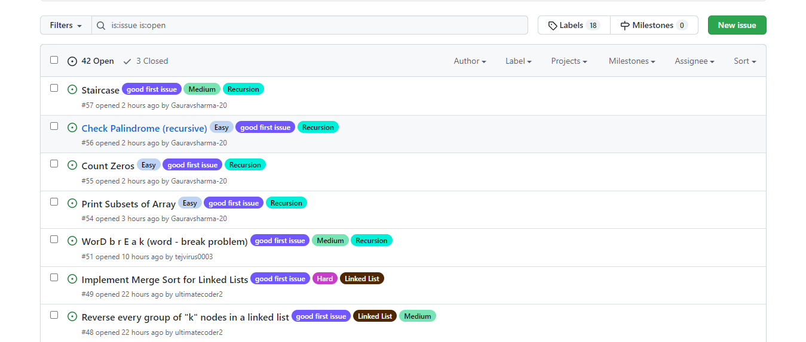
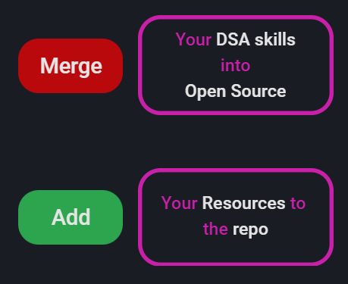
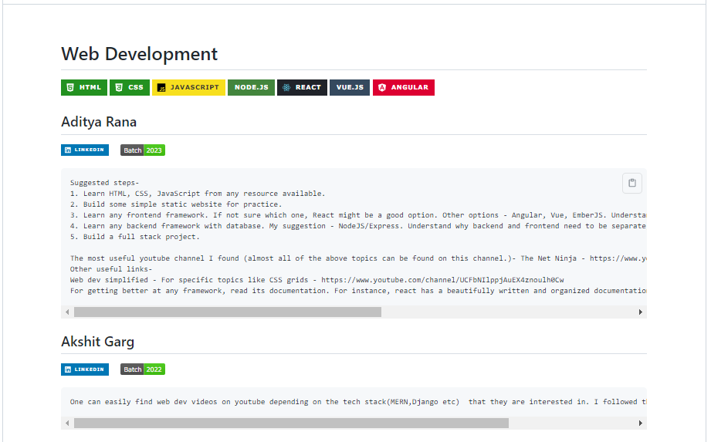
Purpose of pec-css open source repo

Slide 6

INTRO TO THE REPO &
PREREQUISITE
INSTRUCTIONS
Install VS-Code : Download Link
Install Git Video
How to Create a PR (Pull Request)
Specific to our repo
General detailed explanation

Slide 7
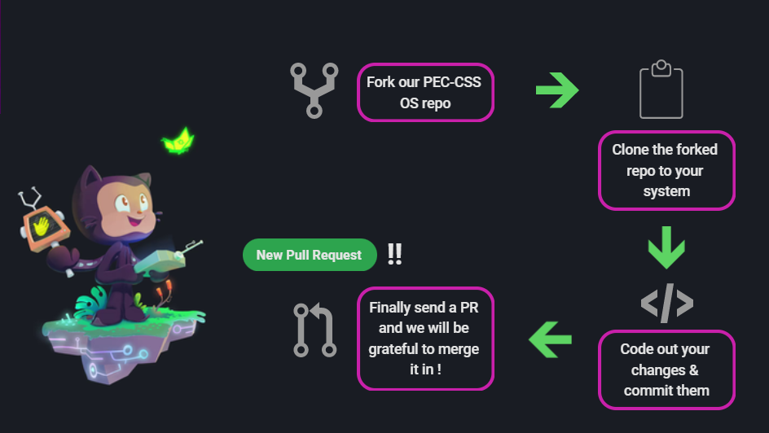
Make your first PULL request !

Slide 8
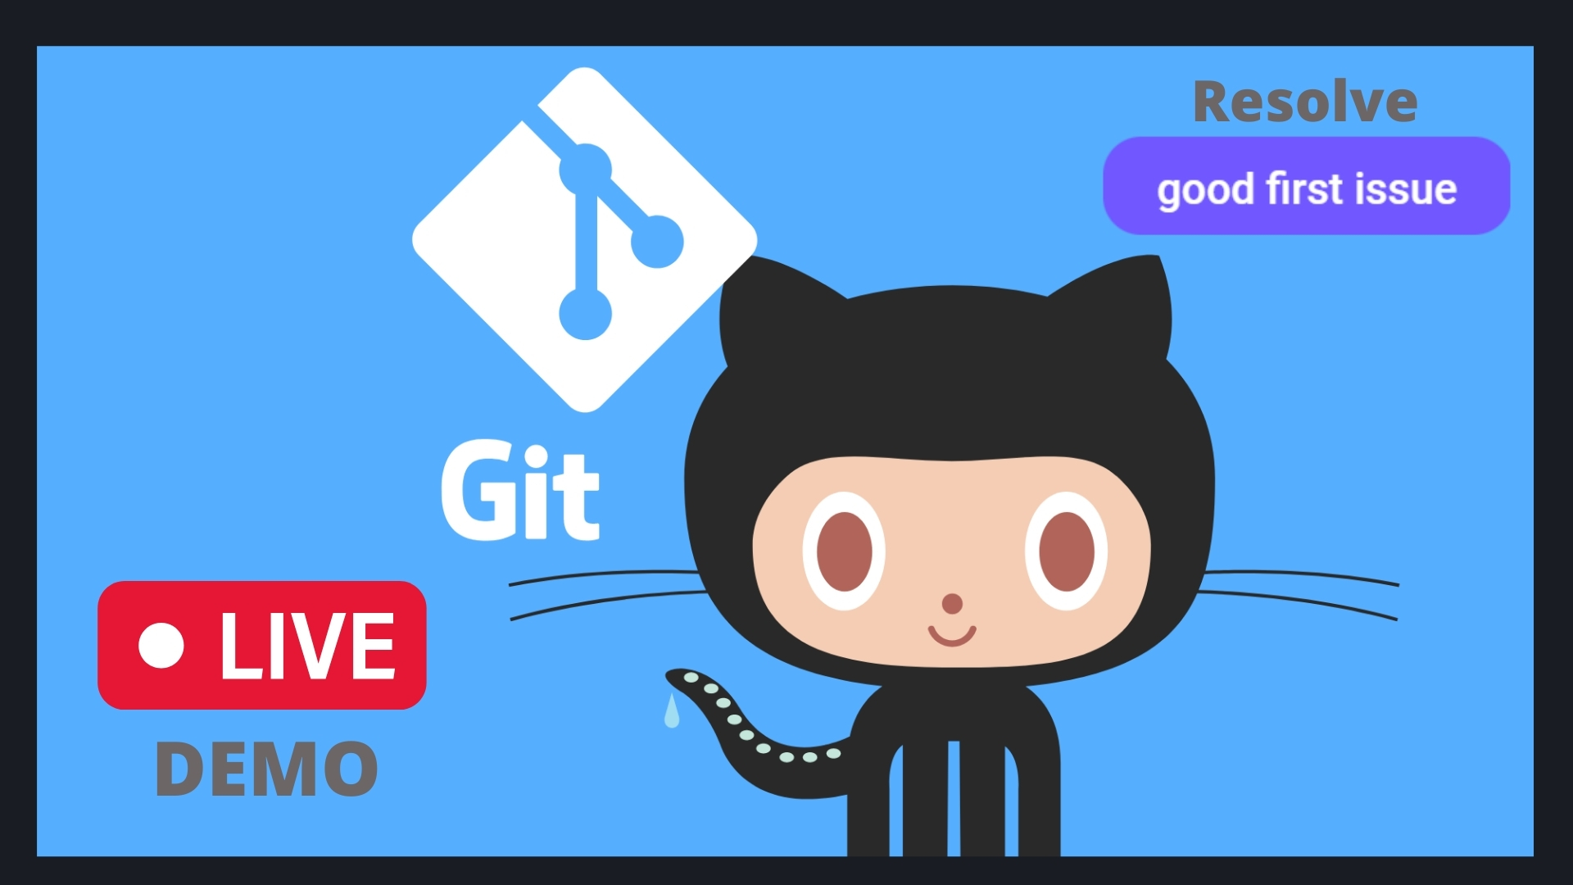

Slide 9
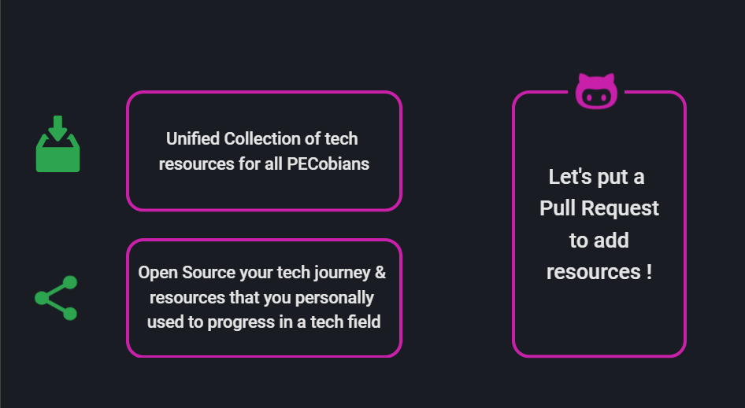
Add your resources to the repo as well !

Slide 10
Common GIT Commands
git checkout -b name_of_branch //creates a new branch
git add .
git commit –m "message"
git push origin name_of_branch
git pull origin name_of_branch

Slide 11







Where to find Open source Projects?

Slide 12
PLANS FOR FUTURE EVENTS
GSoC Insiders
Hacktoberfest
Long term Projects

Slide 13
THANK YOU

